Slide 1
OpenGL – Solar System
Jonathan Schlueter

Slide 2
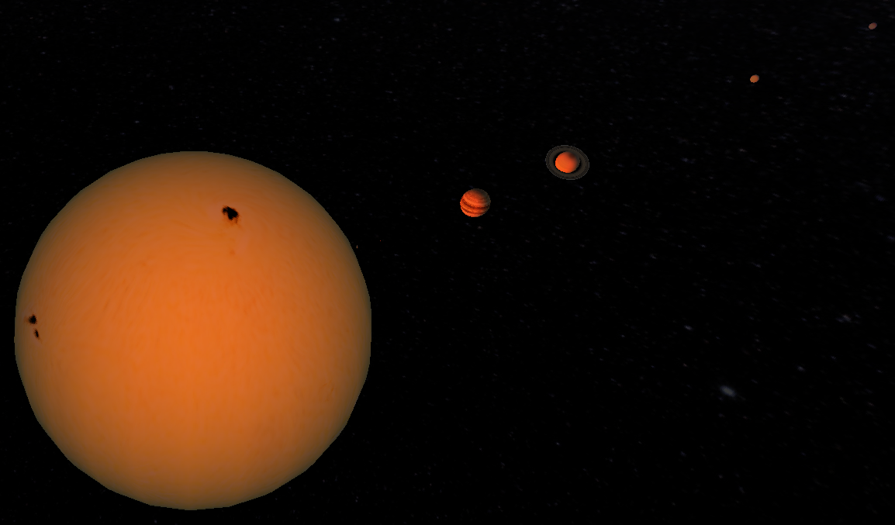
Overview
Solar System Visualization
To scale
Interactive controls
Textured planets
Skybox
In-Progress: Spaceship Flight

Slide 3
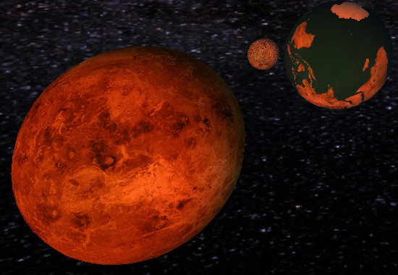
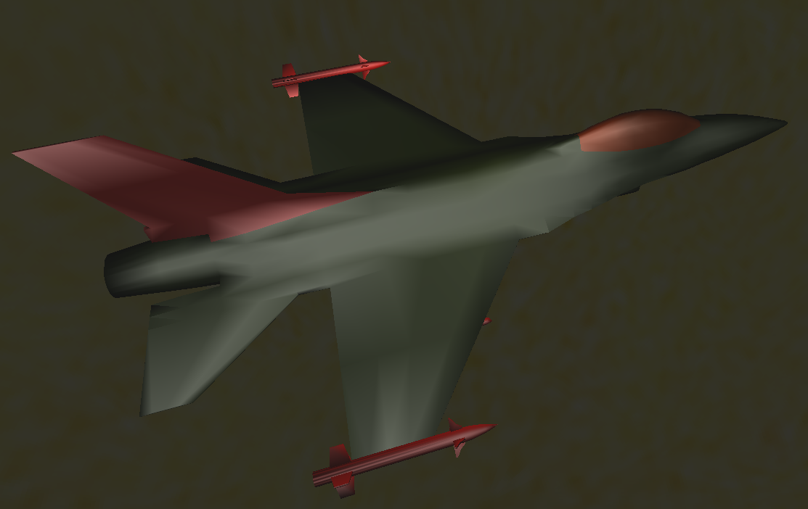
The Scene
Illuminating Sun
All 8 rotating/orbiting planets
Earth’s moon (hierarchical)
High-resolution skybox
Loaded spaceship model

Slide 4
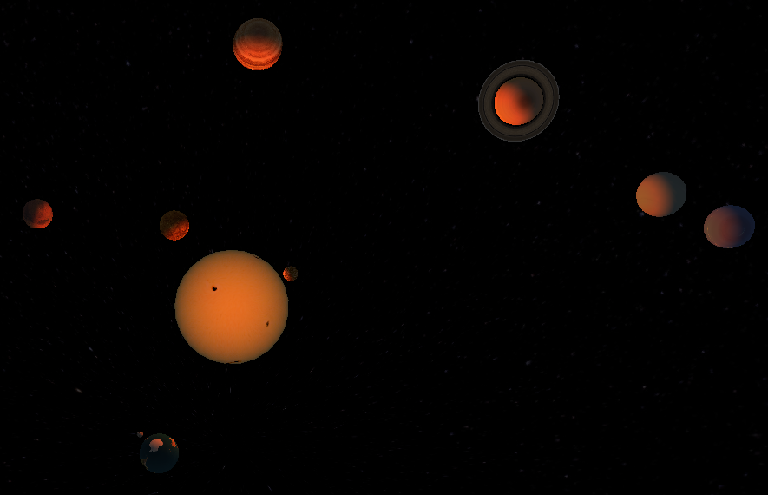
Interaction
Pause simulation (‘p’)
Change simulation speed (‘+/-’)
Toggle to-scale mode (‘t’)
Pause local rotation (‘r’)
Rotate/Zoom camera (L/R Mouse)
In-Progress: Spaceship movement (‘w/a/s/d’)

Slide 5
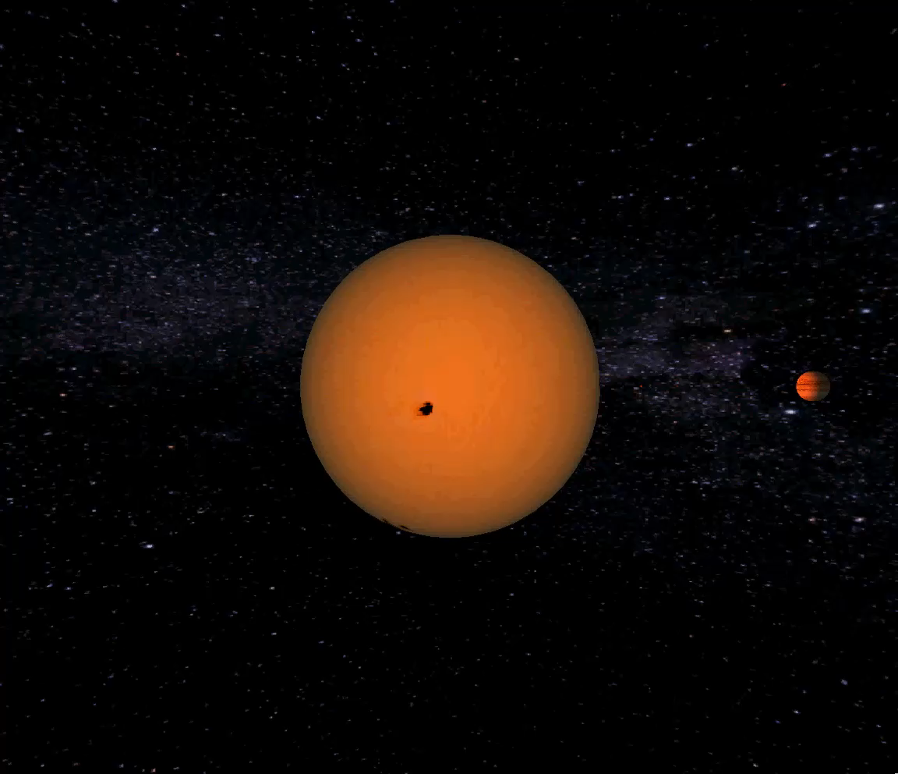

Slide 6
Topics Covered
Hierarchical models
Extensive object transformations
Texturing
Camera manipulation
Model loading
GLUT
In-Progress: normal mapping

Slide 7
Future Work
Normal-mapped planets
Player-controlled spaceship movement
Follow cams for planets and spaceship

